Slide 1
(420-1N6-AB) Technical Support
Fall 2022

Slide 2
The Teacher
Notes:
Lecture notes go here

Slide 3
About Me
Michael Haaf
Office:
Penfield P235
Office Hours:
TBD (will be printed on my office door, P311)
Other hours: by appointment (MIO)
Contact:
MIO (I check every day)
michael.haaf@johnabbott.qc.ca
Course Website:
Léa

Slide 4
The Students
Notes:
Lecture notes go here

Slide 5


About You
Who are you?
Name
Hobbies/interests
any interesting previous/current jobs you’ve had?
an interesting thing you’d like to do or have done!
Why Computer Science?

Slide 6
The Course
Notes:
Lecture notes go here

Slide 7
What is 420-1N6-AB? “Technical Support”
This course is a general technical overview of everything to do with modern computers. Topics include:
Computer Architecture (Hardware)
Software Systems (Operating Systems, Drivers, & Applications)
Networking (from LAN to WAN to the Internet at large)
Technical support, troubleshooting, and training others
Best Practises (Backups, system restore, technical documentation, etc.)
Each topic above is a massive field of research and industry in its own right -- you could get a PhD in each! We will be introduced to each briefly, and at a high level (overview) to come away with a better technical understanding than we had before.

Slide 8
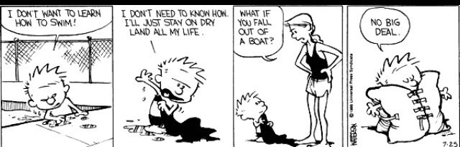
What comes after this course
This course is a prerequisite for
420-2T3-AB -- Information Technology
420-2N5-AB -- Networking
A pass in this course means you have learned enough of the skills taught in this course (see previous slide) to understand next semester’s material

Slide 9
Pondération
2 Hours lecture
4 Hours laboratory
3 hours homework

Slide 10
Requirements
No textbooks!
(1) External HDD ($50 - $100). We use these devices to make system backups and plug them into the lab computers
500 GB is enough. However, 1TB or more is better value (better price/GB)
Must be an External HDD that has USB 3.0 (portable, to plug into the lab computers)
Example: https://www.amazon.ca/Western-Digital-Elements-Portable-External/dp/B06VVS7S94/
(2) Multihead Screwdriver (< $20)
For assembling computers!
Example: https://www.amazon.ca/Picquic-88001-Multi-Bit-Screwdriver-Full-Size/dp/B01KZ0AQDU/
Please let me know as soon as you can if you have any problems acquiring these things. I’m here to help!

Slide 11
Classroom Policies & Student Success
Notes:
Lecture notes go here

Slide 12
Class & Lab Time
Fall 2022:
August 22nd to December 9th, 2022
http://www.johnabbott.qc.ca/academics/registrar/academic-calendar/ -- check here for holidays!
Lecture Time:
Section 1 (taught by Youmna Badawy)
Section 2 (us!)
Monday 14:30 – 16:00
Wednesday 14:30 – 16:00
Friday 14:30 – 17:30

Slide 13
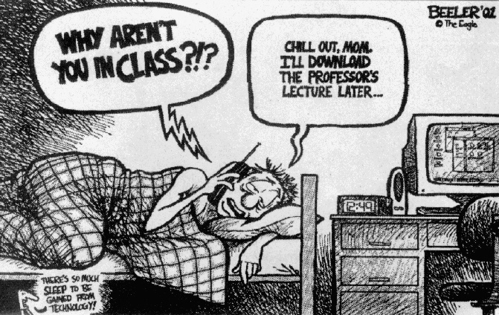
Attendance
I will freely provide my slides and as many course resources as necessary to supplement this class.
But! My course notes are not a substitute for regular class attendance. Hands on experience is key!

Slide 14
Support Material
Class Slides (available on Lea)
Lab exercises
Assignments
Your class notes
Other:
Handouts
Suggested reading material
Suggested textbooks

Slide 15
Grading Policies
Assignments: 4 assignments 60%
Tests: Test 1 20%
Test 2 20%
No final exams!
See Course Outline for tentative schedule

Slide 16

Feedback
Let me know how things are going in the course:
Am I covering the material too slowly or too quickly?
Are the slides material clear?
Can you read my handwriting?
Can you hear me well?
Does my answer make sense?
Do you understand the assignment questions?
Etc.

Slide 17
How we’ll learn to stop worrying and love our grades
Attend all classes
(MIO me if you need to miss a class for an important reason)
Complete your assignments on time
But! Endeavour to at least hand in assignments. Better late/incomplete than never.
Reach out to me if you ever feel stuck or overwhelmed
If you miss a deadline, please don't ignore it!
MIO me. I’m here to help! And that includes for late/incomplete assignments.
Persistence is important.
A lot of things will seem new and confusing at first.
Everyone will start at a different level of familiarity with these technical subjects.
But! Everyone can learn these subjects. With time, practise, and patience, you will get better at computer science -- and at learning in general

Slide 18
Academic Success
Try your best to get to know other students!
Help eachother out! You will learn much more from working through the assignments yourself and from teaching eachother than you will from listening to me
And, building relationships with new peers is, in my opinion, the best part of school
Use a Study Schedule and Time Management Strategies
Attend classes & labs regularly
Communicate with your instructor (me! I’m here to help)
Use Textbooks, Online Articles, and Readings
Most technical knowledge about computers is freely available online. For the curious, there are many great papers to find on any given subject
Since the pandemic there has been an explosion of high quality Youtube tutorials as well. I will often provide these as supplementary materials myself
But! there is no substitute for attending and working through problems yourself. And! beware of internet hucksters -- not everyone actually knows what they’re talking about.
Seek out help if you are struggling (from me, from peers, from John Abbott student services, etc.)

Slide 19
COVID Info
Read updates from the college (communicated by MIO and email)
Compare with other CEGEPs, schools, and regions. Are we getting the quality of protection that we need? Stay informed and think critically
Some particular rules (applies to all classes, not just mine):
Mind respectful distance when entering and leaving classrooms and labs
If you have flu-like symptoms, do not come to class! See https://www.johnabbott.qc.ca/faq-and-one-stop-shop/ for details
All we can do is our best to keep eachother safe and to learn what we can while we’re here. Please let me know if you have any questions or concerns -- I’m here to help

Slide 20
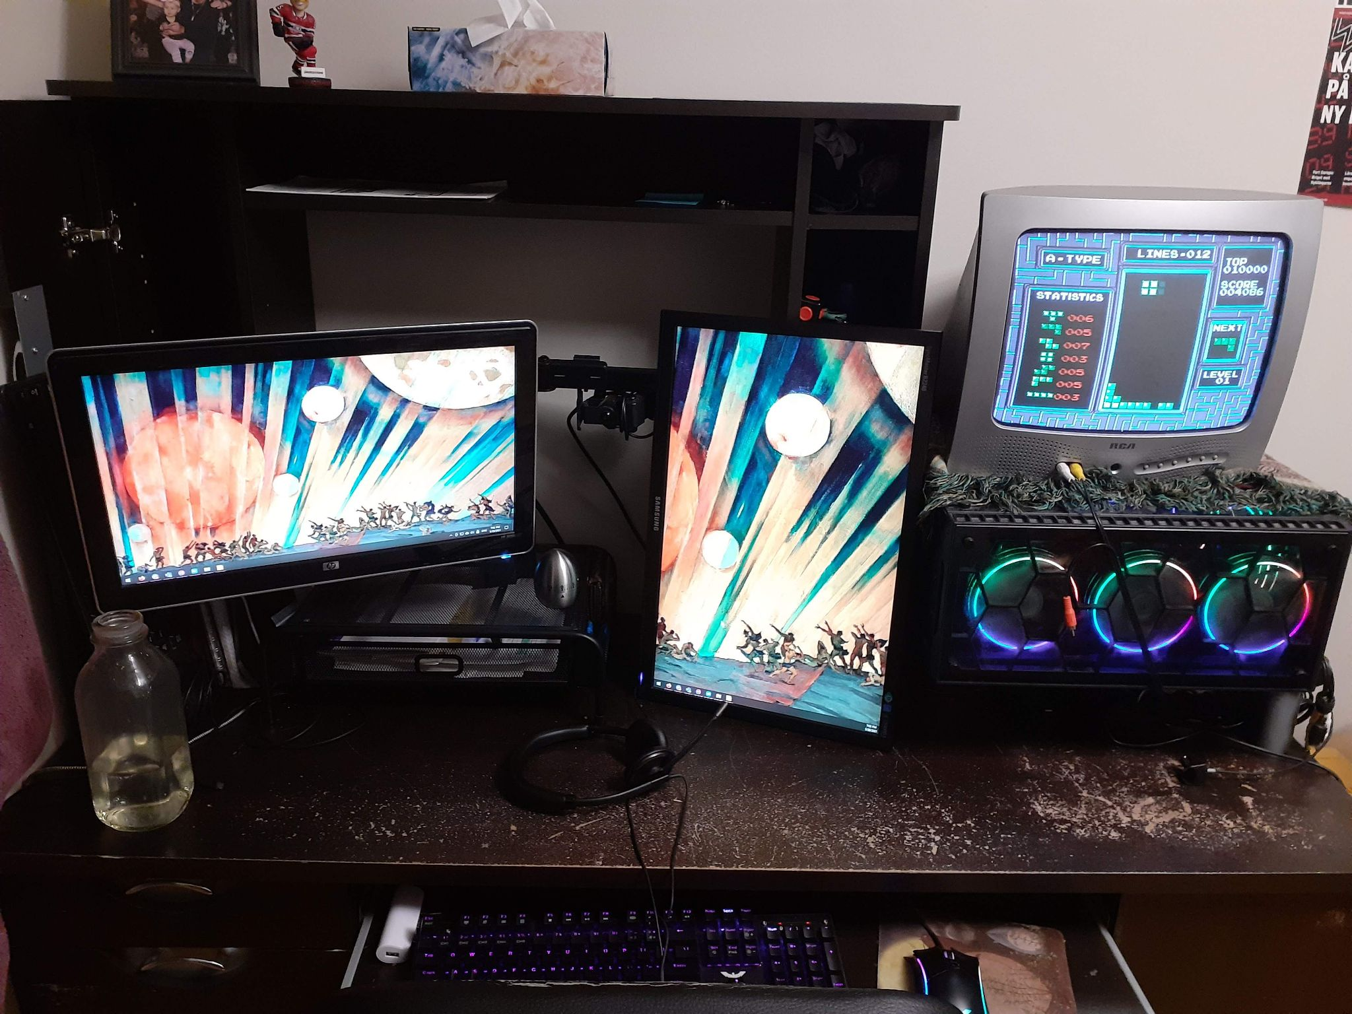
Wednesday
an introduction to computer hardware!
by the end of the week: we can easily identify all of the hardware components depicted here

Slide 21
Q & A
Notes:
In Slide Show mode, click the arrow to enter the PowerPoint Getting Started Center.

